Slide 1
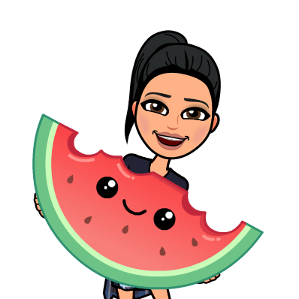
Week of 6/1-6/5
Monday | Tuesday | Wednesday | Thursday | Friday
20 minutes Imagine Learning 20 minutes Imagine Math Unit 10 Week 2 4 Benchmark packet pages 1 math page (Blue book in Kinder Bundle) Listen to the Story FORCES Retell a key detail from Chapter 1, 2 , and 3. Write a sentence about the story using the word “saw”. Optional Practice Google Classroom Reflex Math | Benchmark Advance Online ThinkCentral Unit 5 TEST My Shared Reading: What Makes a Soccer Ball Fly? pg. 18 2 math pages (Blue book in Kinder Bundle) Mystery Science Spring How do Flowers Bloom in the Spring? Draw/Write: Print the extension activity and make the flower bloom. Optional Practice Google Classroom Khan Math | 20 minutes Imagine Learning 20 minutes Imagine Math Unit 10 Week 2 4 Benchmark packet pages 1 math page (Blue book in Kinder Bundle) READ/Listen to the story USE A MULE Write: 2 sentences using the words on the last page. They have the long U sound. Draw pictures to match your sentences. Optional Practice Google Classroom Reflex Math | Benchmark Advance Online ThinkCentral Unit 5 TEST My Shared Reading: What Can a Magnet Do? pg. 20 2 math pages (Blue book in Kinder Bundle) Zoom Meeting Please have a pencil, paper, and some crayons to use for our meeting. • Red 9:00-9:30 • Orange 9:00-9:30 • Green 9:30-10:00 • Blue 9:30-10:00 • Purple 9:30-10:00 Optional Practice Google Classroom Reflex Math | 20 minutes Imagine Learning 20 minutes Imagine Math Unit 10 Week 2 4 Benchmark packet pages 2 math pages (Blue book in Kinder Bundle) Scholastic Science Spin Magazine Read Aloud Classroom password is sskinderleao Here Comes the Sun Optional Practice Google Classroom Khan Math

